Slide 1
IBM Applied Data Science Capstone
Exploring the Food Culture and Diversity of Gurgaon, India
By: Karan Sud
May 2020

Slide 2
Business Problem
Food Diversity is an important part of an ethnically diverse metropolis.
Objective: To examine the neighbourhoods of Gurgaon for food culture and diversity.
Idea of this project is to categorically segment the neighbourhoods of Gurgaon city into major clusters .and examine their cuisines.
Target Audience: 1) Individual migrating to the city for work or education
2) Businessman willing to open his or her restaurant
3) Investors looking to invest in the F&B industry in Gurgaon

Slide 3
Data
Data Required:
List of neighbourhoods in Gurgaon
Latitude and longitude of those neighbourhoods
Venue data related to restaurants and cuisines
Data Sources:
https://www.mapsofindia.com/pincode/india/haryana/gurgaon/
Geocoder package for latitude and longitude coordinates.
Foursquare and Zomato APIs

Slide 4
Methodology
Web scrapping the page for a list of neighbourhoods.
Get latitude and longitude coordinates using Geocoder.
Use Foursquare API to get venue data and Zomato API for avg. price and rating.
Visualise and explore the dataset obtained. Plot on a map.
Group data by neighbourhood and most common venue category
Take the mean of the frequency of occurrence of each venue category
Perform clustering on the data by using k-means clustering
Visualize the clusters in a map using Folium

Slide 5
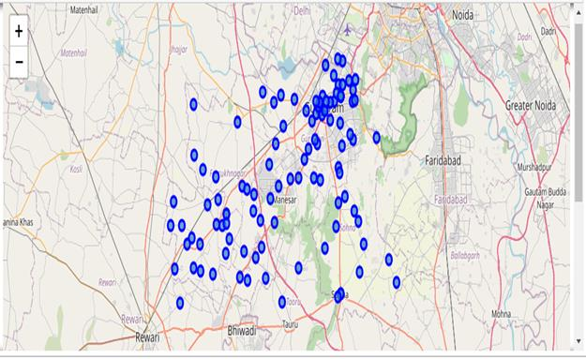
Map of Gurgaon with neighbourhoods

Slide 6
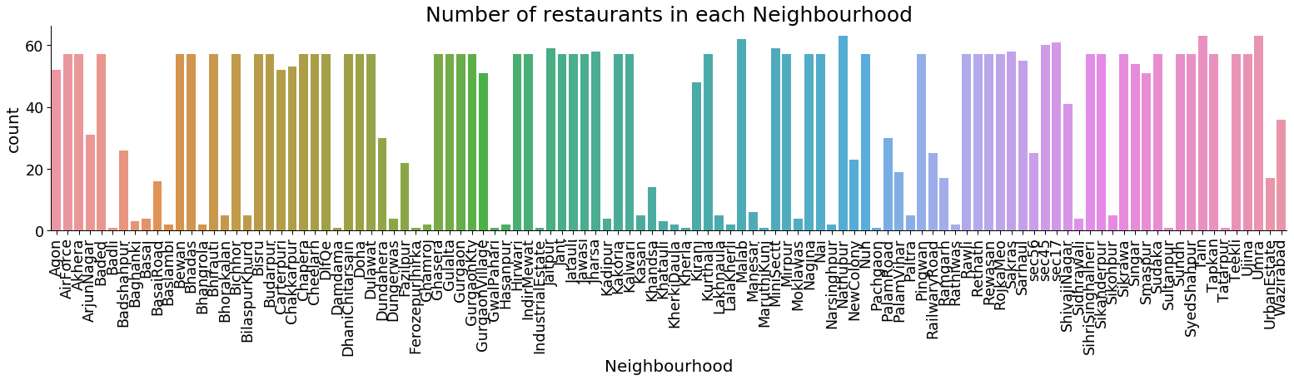

Slide 7
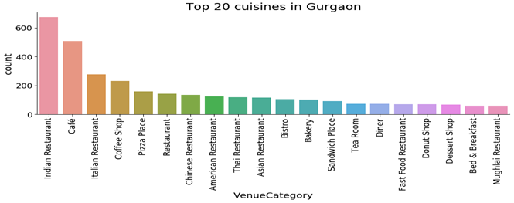

Slide 8
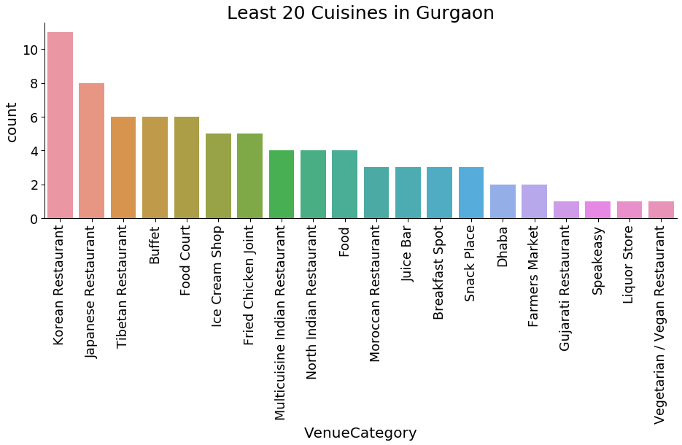

Slide 9
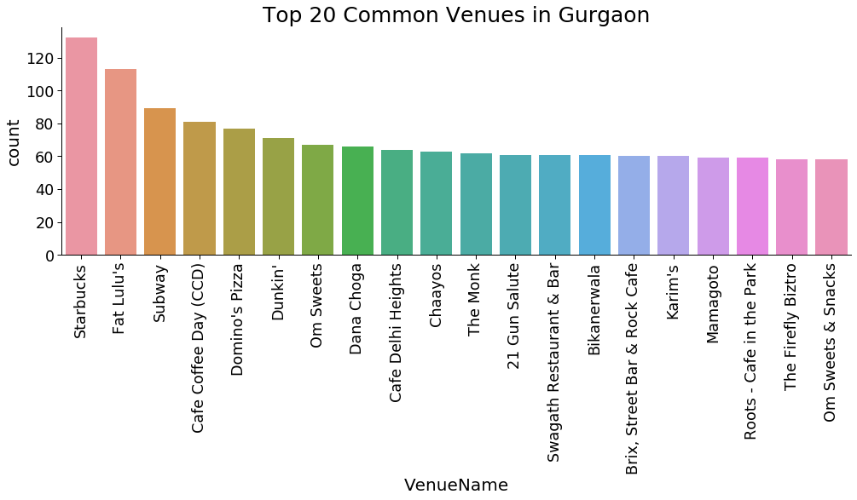

Slide 10
Results
The data was segmented into 8 clusters (k=8)
Cluster 0: Biggest cluster, hub of Gurgaon, most amount of restaurants opened.
Cluster 1: This cluster lies on the outskirts of Gurgaon.
Cluster 2: This cluster contains only a single Neighbourhood ‘Kherla’.
Cluster 3: Near the highway , 1st most common venu e is Snack place.
Cluster 4: Factories in this cluster, workers prefer cafes around.
Cluster 5: Contains only a single neighbourhood ‘Industrial Estate’
Cluster 6: Cluster has Chinese restaurant as the 1st most common venue
Cluster 7: Close to the central Gurgaon hub, Pizza place most common.

Slide 11
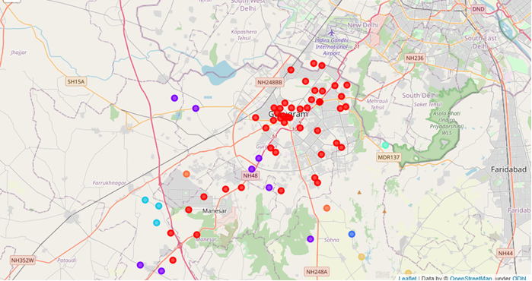
Cluster Map

Slide 12
Discussion
Most of the restaurants are concentrated in the central area of Gurgaon.
Clusters 2 and 5 have a single neighbourhood very far from the central area.
Cluster 7 is very close to the central area and has potential for future restaurants
Opening new restaurants in neighbourhoods in cluster 1 and cluster 7 beneficial.
Clusters 2,4 and 5 don’t have enough potential yet for success of a restaurant.

Slide 13
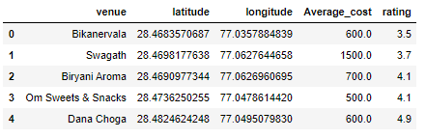
Zomato API
We use Zomato API to get information about venues such as average price for 2 people and rating of the venue.
We will see Indian Restaurants for venues in cluster 0
We make a separate DataFrame after making the API call

Slide 14
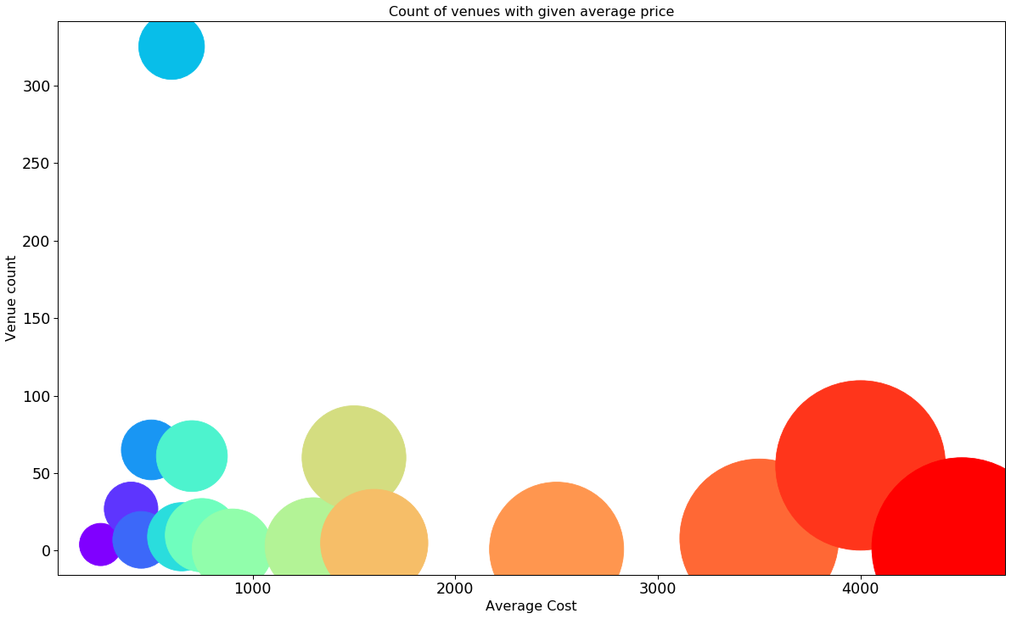
Average Price

Slide 15
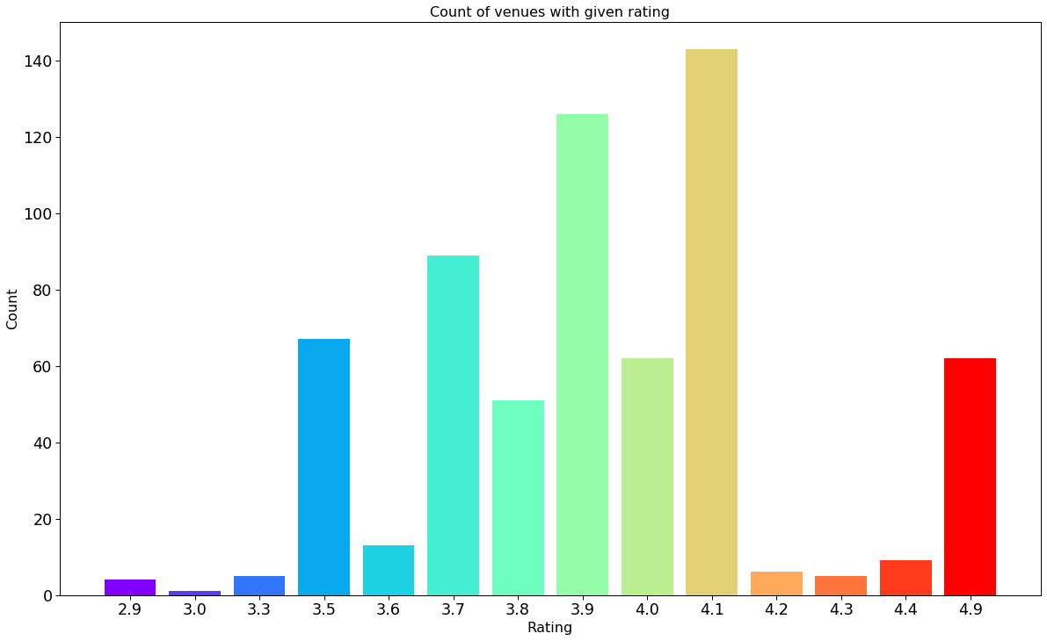
Review

Slide 16
Conclusion
We answered our business question.
‘Indian Restaurant’, ‘Café’, ‘Pizza Place’, ‘Coffee shop’, and ‘Italian Restaurant’ are the top 5 cuisines in Gurgaon.
Findings of this project will help the relevant stakeholders to capitalize on the opportunities on high potential locations while avoiding overcrowded areas in their decisions to open a new restaurant in Gurgaon.

Slide 17
Thank you

